Slide 1
Sport Hub to buy sport tickets for different sport events in different cities for different games and leagues
Team - 3
Project Statement
By:-
Miraj Vekaria (A20504946)
Hemanth Thathireddy (A20525346)

Slide 2
Project Overview
The Sports Hub project aims to develop a web-based platform that allows users to purchase tickets for various sporting events in various cities, for various games and leagues, and also allows event organizers to register their events on the platform. The platform will have an easy-to-use interface that allows users to search for and filter events based on location, date, team, and league. Users will be able to view available seats, choose and purchase tickets, and receive email confirmation and e-tickets. To ensure seamless transactions and secure payment processing, different payment gateways will be integrated. The Sports Hub will use web technologies to provide users with a fast and responsive experience, allowing them to quickly find and purchase tickets for their favorite sporting events.

Slide 3
Requirements
Users must be able to search for any sports events by league name or by city and by game.
The platform must offer comprehensive details about each event, including the location, the time and day, the teams and players, and the cost of tickets.
The platform must show venue seating arrangements and enable users to choose particular seats.
The platform needs to provide a shopping cart feature that lets customers add no. of tickets and pay for them all at once.
To securely accept credit/debit card, Apple Pay or PayPal payments, the platform must integrate with a payment gateway.
The platform must email to confirm the transaction.
Users must be able to see their account's previous and future transactions on the platform.
According to venue and league rules, the platform must have a cancellation and exchange policies. Based on the rules and policies, users must be able to cancel the tickets or modify their seats.
The site must give customers the chance to sign up for alerts about upcoming events.
Users must be able to create the account. It's optional, if the user doesn't want to create an account, then they must be able to browse events as a guest but not checkout. Event Organizers must be able to create accounts.
Only event organizers must be able to create/ modify/ delete events.
Event organizers must be able to fill out all the information such as event name, location, date and time, Description, and add seating arrangement chart.
Platform must provide an accurate error message when any failure happens.
Platform must execute each and every operation smoothly.

Slide 4
Features
Sign up and Login
New users can create an account by providing Name, email, password. An existing user can log in using the email and password. Also, event organizers can create an account by providing the same information.
Visibility: Visible to user and event organizers
Browse sports events by league, Game or city name
Users can search for any sports event by Name, City name or league name by using the search bar.
Visibility: Visible to user
View event information
By clicking on the event, the User can see the information about the event venue, Date, ticket prices, and event name.
Visibility: Visible to user
Seat selection and get tickets
Users can select seats from available seats and add them to cart.
Visibility: Visible to user

Slide 5
Features
Pay through many tenders
After choosing tickets, users can pay through many options such as credit card, debit card, Apple Pay or PayPal.
Visibility: Visible to user
Get tickets in email
After successful checkout, users will get their tickets on their email.
Visibility: Not visible to user
View seating arrangements for specific events
Users can see the seating arrangements when choosing the tickets.
Visibility: Visible to user
Notify subscribed users about upcoming events
Subscribed Users will get email notification about upcoming events.
Visibility: Not visible to user
Cancel or modify tickets
Users are able to cancel the tickets and modify the seats only if it is allowed by the event organizer.
Visibility: Visible to user

Slide 6
Features
Support via email, phone or live chat.
Users can contact us when they require assistance regarding their order or in case of any issue occurs.
Visibility: Visible to user
Can see order History
Registered users can see their past purchases and also can see the upcoming purchases
Visibility: visible to user
Can add/modify/delete events
Event organizers can create/ modify / delete an event. Apart from that, they can provide information about events such as Name, location, Date and time.
Visibility: Visible to event organizers.

Slide 7
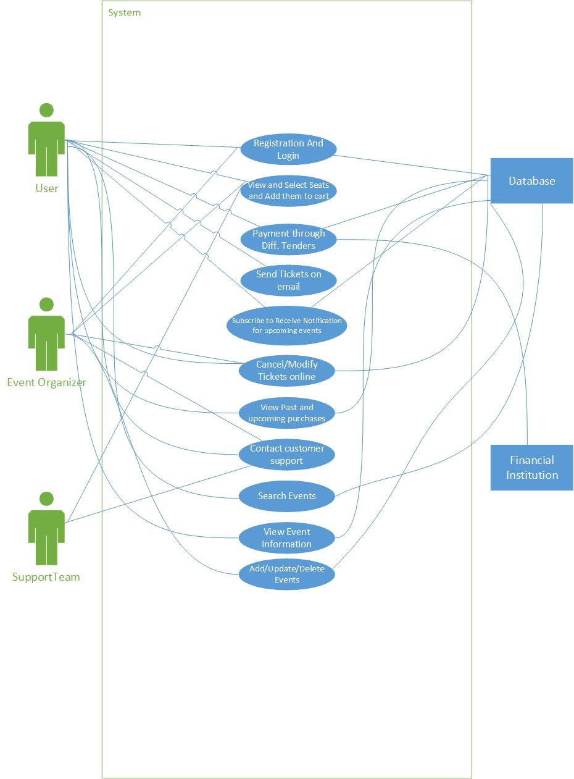
Use-Case Diagram

Slide 8
Use-Cases
User registration and Login:
User registration and login feature is used to create user accounts, where users can provide their personal information such as name, email, and password. This feature allows users to view past purchases. It also provides a secure and personalized experience for the users. Event Organizers can create an account by providing the same information. All the information of the accounts will be stored in the database.
Search Events:
This feature allows users to search for the specific event by event name, location, or date and time. It provides a convenient way to search for desired events of a user. Database has all the information of events.
View Event Information:
This feature shows event information such as location, league name, date and time, description of event to users. Database has all the information of events.

Slide 9
Use-Cases
Add/Update/Delete Events:
This feature allows event organizers to register their event or modify the event information, or can delete an event on the portal. The database will update the information according to event organizer input.
View, Select seats and add to cart:
This feature allows users to view the seating chart and availability for specific events. It helps users to choose the best seats available based on their preferences and budget. And add selected seats to cart to buy at once. The Event Organizer will contact the Support team to add seating arrangements.
Payment through Different Tenders (Credit card, debit card, Apple Pay, PayPal etc.):
This feature allows users to choose from different payment options, such as credit card, debit card, PayPal, and other payment gateways. It provides users with a flexible and convenient way to make payments for their purchases. All tenders' validity will be checked through financial institutions. And after checkout, all the transaction data will be stored in the database.

Slide 10
Use-Cases
Send Tickets on Email:
This feature allows users to receive electronic tickets and confirmation email for their purchases. It helps users to keep track of their activities on the platform and also provides a secure and convenient way to access their tickets.
Subscribe to receive notification for upcoming events:
This feature allows users to receive notifications for upcoming events. It helps users to stay updated on the latest events. The database will store all the subscribed emails.
Cancel/Modify tickets online:
This feature allows users to cancel or modify tickets, if allowed by the event organizer. It provides users with a flexible and convenient way to manage their purchases. Event organizers will set rules and policy for cancellation and modification. The database will be used to validate the order.

Slide 11
Use-Cases
View past and upcoming purchases:
This feature allows users to view their past and upcoming purchases in their user account. It provides users with a complete overview of their activities on the platform. Database has the information of every order of a user.
Contact customer support via email, phone, or live chat:
This feature allows users to contact customer support via email, phone, or live chat. It provides users with a way to get assistance and support for their queries and issues. Event organizer will contact the support team to add seats layout for the events.
Event Organizers add/delete/modify event information:
This feature allows event organizers to add, delete, and modify event information in the app to provide latest and accurate information to users

Slide 12
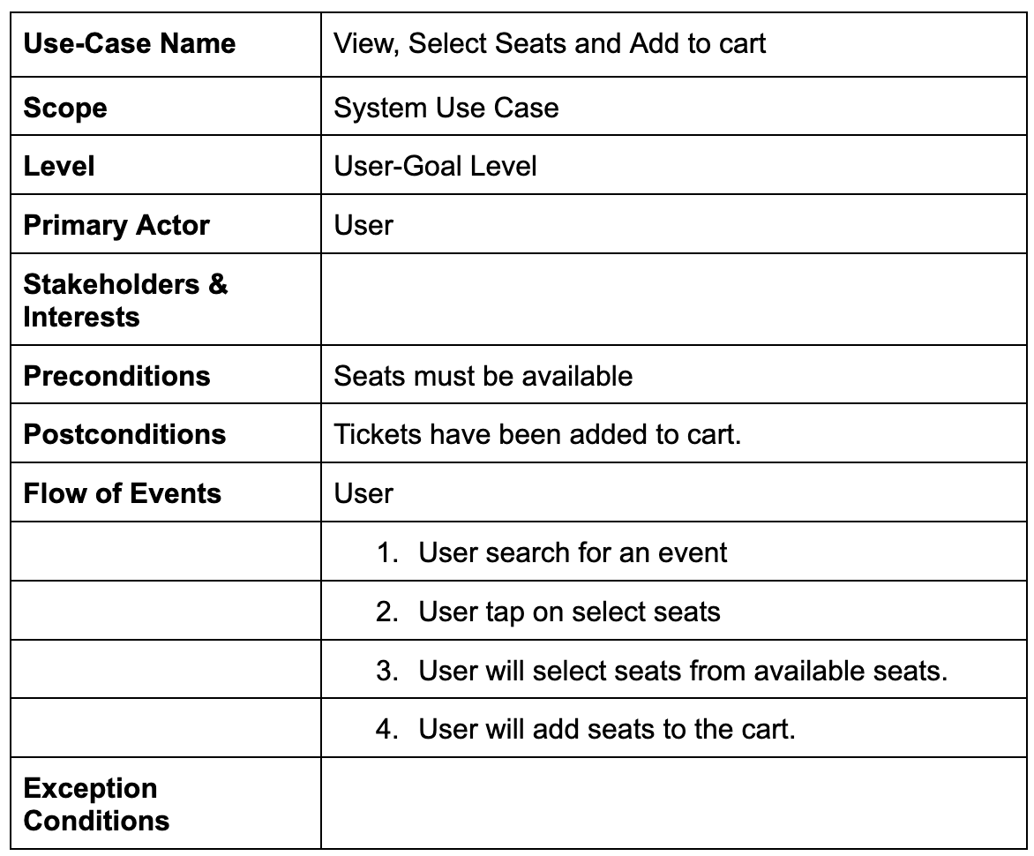
Use-Case fully dressed format

Slide 13
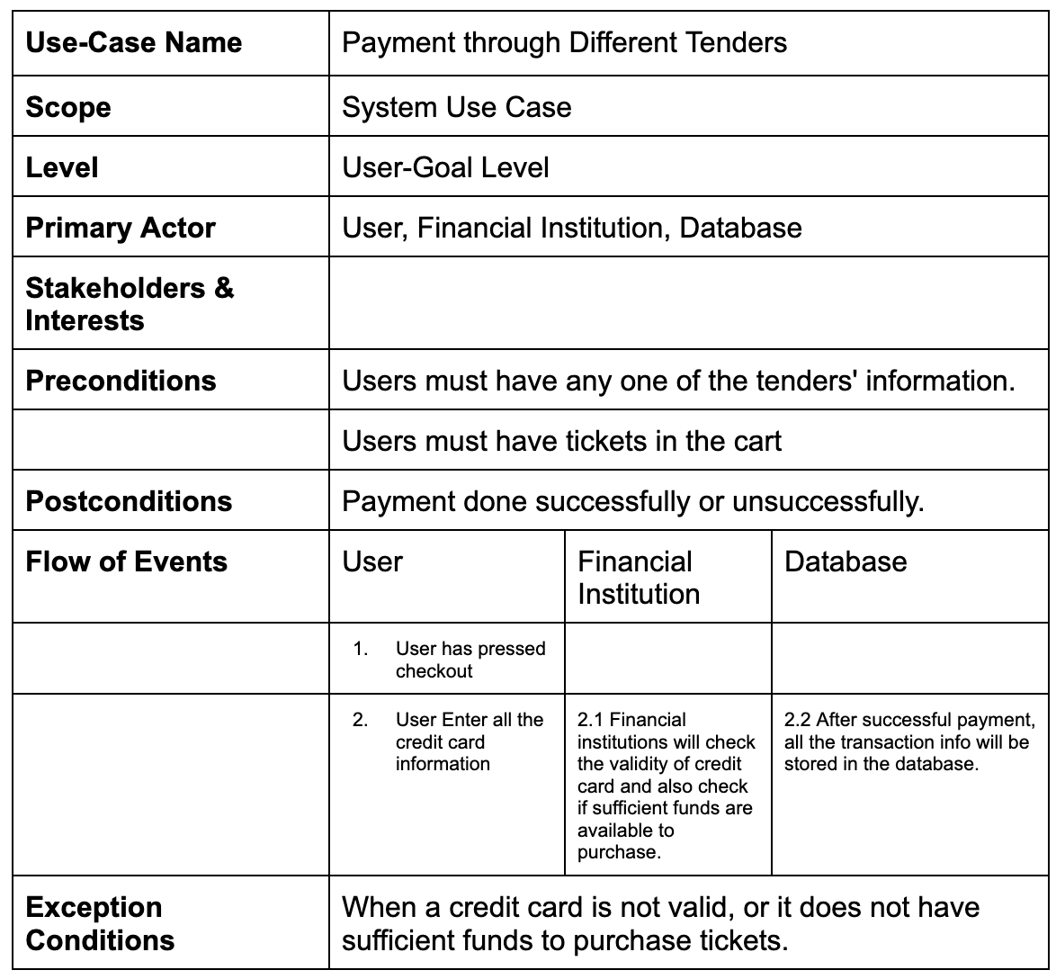
Use-Case fully dressed format

Slide 14
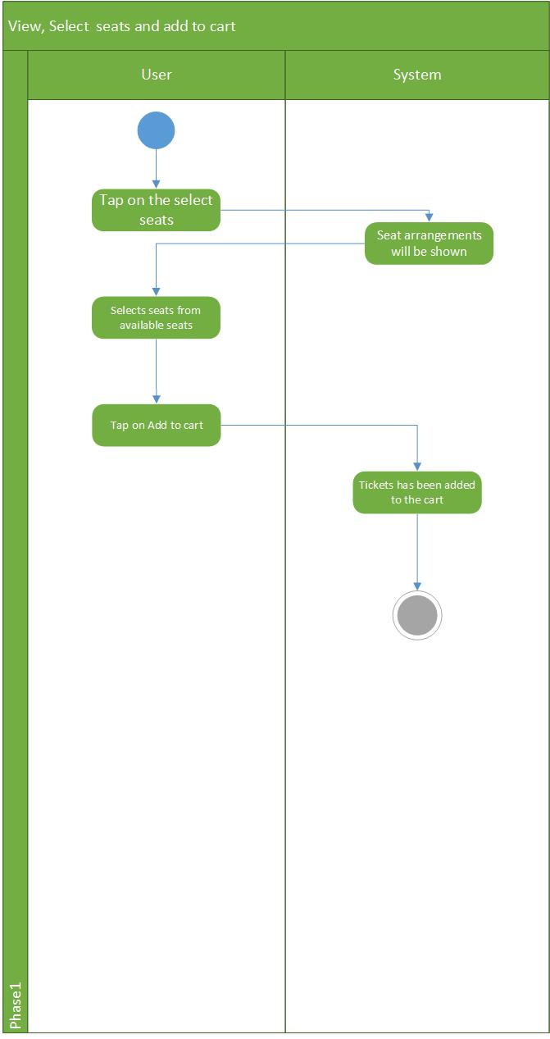
Activity Diagram:
Use-Case:View, Select seats and add to cart:
This feature allows users to view the seating chart and availability for specific events. It helps users to choose the best seats available based on their preferences and budget. And add selected seats to cart to buy at once. The Event Organizer will contact the Support team to add seating arrangements.

Slide 15
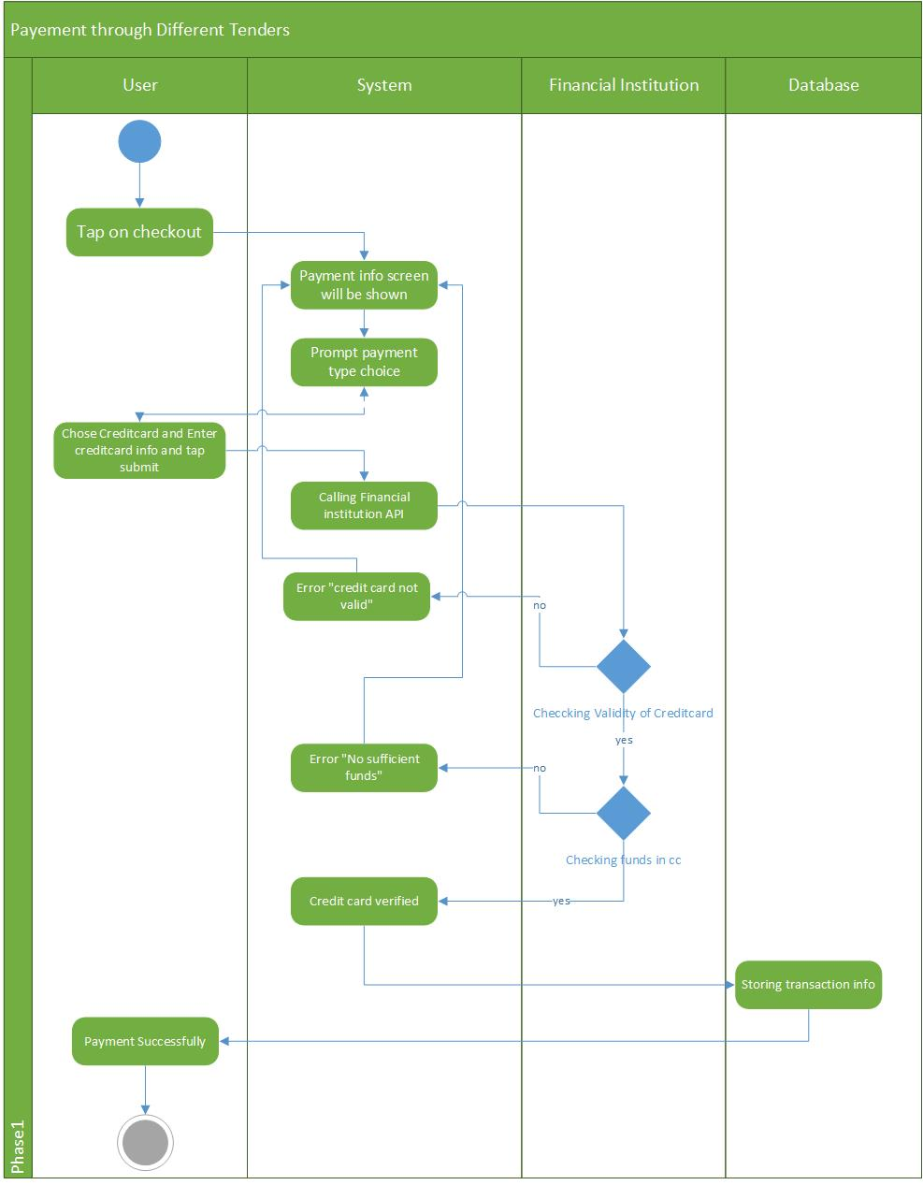
Activity Diagram:
Use-Case: Payment through Different Tenders (Credit card, debit card, PayPal etc.):
This feature allows users to choose from different payment options, such as credit card, debit card, PayPal, and other payment gateways. It provides users with a flexible and convenient way to make payments for their purchases. All tenders' validity will be checked through financial institutions. And after checkout, all the transaction data will be stored in the database.

Slide 16
Thank You

